Slide 1



Electrical Engineering Department
JECRC , Jaipur
TESLA 10/17
TESLA 10/17
October
2017

Slide 2

TESLA
10/17
What’s
Inside....??
1. Director’s message
2. Principal’s message
3. HOD’s message
4. Vision, Mission of Institute
5. Vision, Mission of Department
6. Program Outcomes
7. Placed Students
8. ALS IAS Session
9.
PCRA Workshop
10. Faculty’s Achievements
11. Student’s Achievements
12. Editorial Board

Slide 3

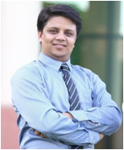

TESLA 10/17
Director JECRC, Jaipur
Message
The JECRC Foundation has been established with a view to provide world class education to our young minds so that they can shoulder their global responsibilities in the years to come.
The JECRC Foundation, now 18 years old, has established itself as one of the leading self-financed colleges in Northen India. This has been primarily due to the large significance that the college puts on the teaching learning process.
The focused areas at JECRC now, apart from teaching learning and placement would be research and development, entrepreneurship and outreach. We also strive to help our students in maintaining and spreading the rich Indian culture and lead the world as our country has done in the past. As you move ahead and rise higher in your life, you must entrench yourself in this unique realm that our culture endows us.
I wish to convey my greetings to all our Alumni and wish each one of them all success in their personal and professional lives.
Best Wishes
Mr. Arpit Agrawal
Director
JECRC, Jaipur

Slide 4
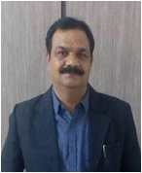
TESLA 10/17
Principal JECRC, Jaipur
Message
A desire can change nothing, a destination can change something but a determination can change everything. Life is a set of problems, an engineer has to solve the problems in their domain areas with strong innovative ideas and scientific knowledge. Your commitment to become an engineer by denoting your journey in Jaipur Engineering College and Research Center will be fruitful and enjoyable in every aspect, the experience you gain from here and the moments you spend here.
Best Wishes
Dr. V. K. Chandna
Principal
JECRC, Jaipur

Slide 5
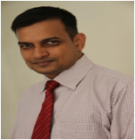
TESLA 10/17
HOD (EE)
JECRC, Jaipur
Message
Nikola Tesla, the well known Serbian- American electrical engineer is quoted as saying "Electrical sources has revealed to us the true nature of light has provided us with innumerate appliances and instruments of precision and has thereby vastly added to the exactness of our knowledge". His words portray the immensely wide and dynamically changing and ever developing world of electrical engineering open to electrical engineer.
It is a great pleasure to see the October, 2017 issue of EE newsletter “Tesla 10/17”. The department has well qualified staff with expertise in Power Systems, Control Systems, Power Electronics and Drives, Electrical Machines and Renewable Energy System assisted by skilled supporting staff. I would like to thank my existing team for their commitment and hard work. The department seeks to combine excellence in education and research. The core values of the department help the students to develop the students their overall personality and made them worthy technocrat to compete and work at global level. Our department has been conducting hands on workshop/seminar/training program since its beginning to keep the faculty and students to enhance the knowledge in their domain.Our mission includes a commitment to prepare students for professional and research activities with an ability to learn independently. I wish you all a successful, long-lived, engineering-based career path.
Best Wishes
Dr. Sandeep Vyas
HOD, Electrical Engineering
JECRC, Jaipur

Slide 6

Vision of the Institute
TESLA 10/17
To become a renowned centre of outcome based learning, work towards academic, professional, cultural and social enrichment of lives and communities .
Mission of the Institute
Focus on evaluation of learning outcomes and motivate student to inculcate research aptitude by project based learning.
Identify, based on informed perception of Indian, regional and global needs, the areas of focus and provide platform to gain knowledge and solution.
Offer opportunities for interaction between academia and industry.
Develop human potential to its fullest extent so that intellectually capable and imaginatively gifted leaders may emerge in the range of profession.

Slide 7
Vision of Department
TESLA 10/17
To Emerge as a Centre of Excellence in teaching in the area of Electrical Engineering; to serve as a valuable resource for society by promoting excellence.
Mission of Department
M1: To provide professional and ethical guidance to the students to make them employable .
M2: To improve quality of education through different quality development programs for faculty and students .
M3: To encourage students to acquire practical knowledge through projects and participation in national and international events .
M4: To prepare our students for upcoming challenges of life through guidance for competitive examinations .
4

Slide 8
TELSA
10/17
PROGRAM OUTCOMES
Engineering knowledge: Apply the knowledge of mathematics, science, engineering fundamentals, and an engineering specialization to the solution of complex engineering problems.
Problem analysis: Identify, formulate, research literature, and analyze complex engineering problems reaching substantiated conclusions using first principles of mathematics, natural sciences, and engineering sciences.
Design/development of solutions: Design solutions for complex
Engineering problems and processes that meet the
design system components or specified needs with appropriate
consideration for the public health and safety and the cultural, social, and environmental considerations.
Conduct investigations of complex problems: Use research-based knowledge and research methods including design of experiments, analysis and interpretation of data, and synthesis of the information to provide valid conclusions.
Modern tool usage: Create, select, and apply appropriate techniques, resources, and modern engineering and IT tools including prediction and modelling to complex engineering activities with an understanding of the limitations.
The engineer and society: Apply reasoning informed by the contextual knowledge to assess societal, health, safety, legal and cultural issues and the consequent responsibilities relevant to the professional engineering practice.
4

Slide 9
TESLA 10/17
Environment and sustainability: Understand the impact of the professional engineering solutions in societal and environmental contexts and demonstrate the knowledge of and need for sustainable development.
Ethics: Apply ethical principles and commit to professional ethics, responsibilities and norms of the engineering practice.
Individual and team work: Function effectively as an individual and as a member or leader in diverse teams, and in multidisciplinary settings.
Communication: Communicate effectively on complex engineering activities with the engineering community and with society at large, such as, being able to comprehend and write effective reports and design documentation, make effective presentations and give and receive clear instructions.
Project management and finance: Demonstrate knowledge and understanding of the engineering and management principles and apply these to one’s own work, as a member and leader in a team, to manage projects and in multidisciplinary environments.
Life-long learning: Recognize the need for, and have the preparation and ability to engage in independent and life-long learning in the broadest context of technological change.
4

Slide 10
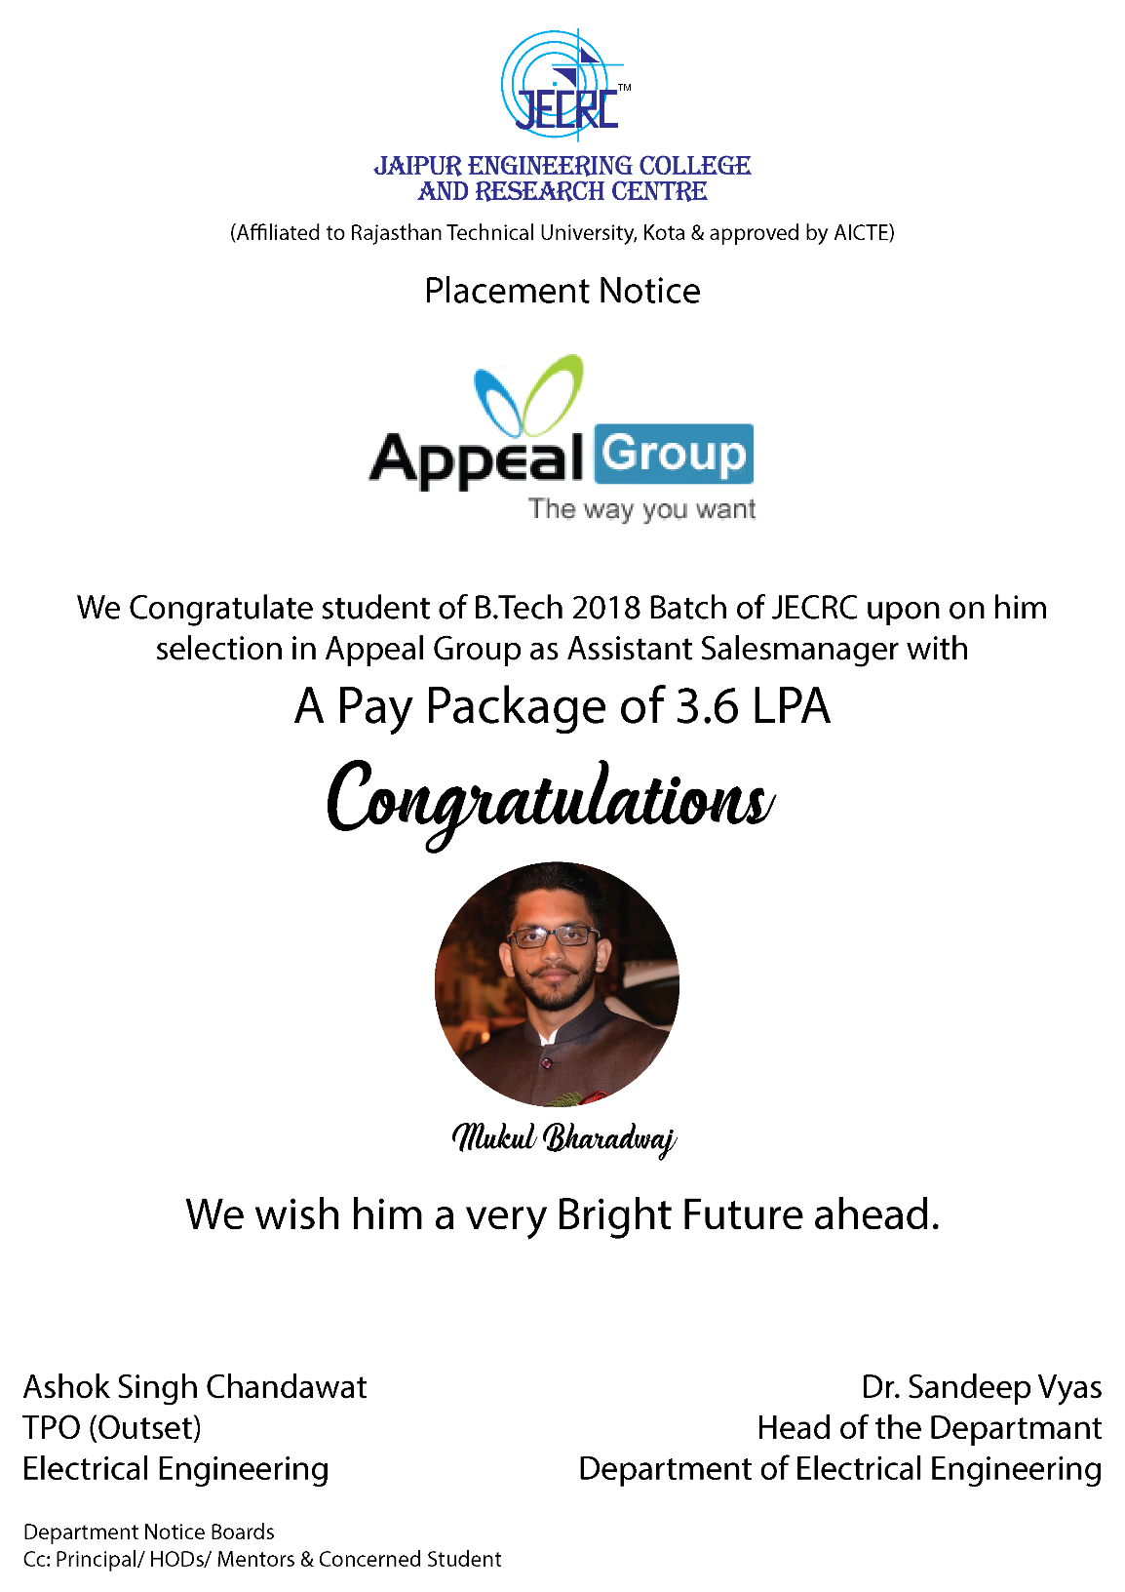
TELSA 10/17
PLACED STUDENTS

Slide 11
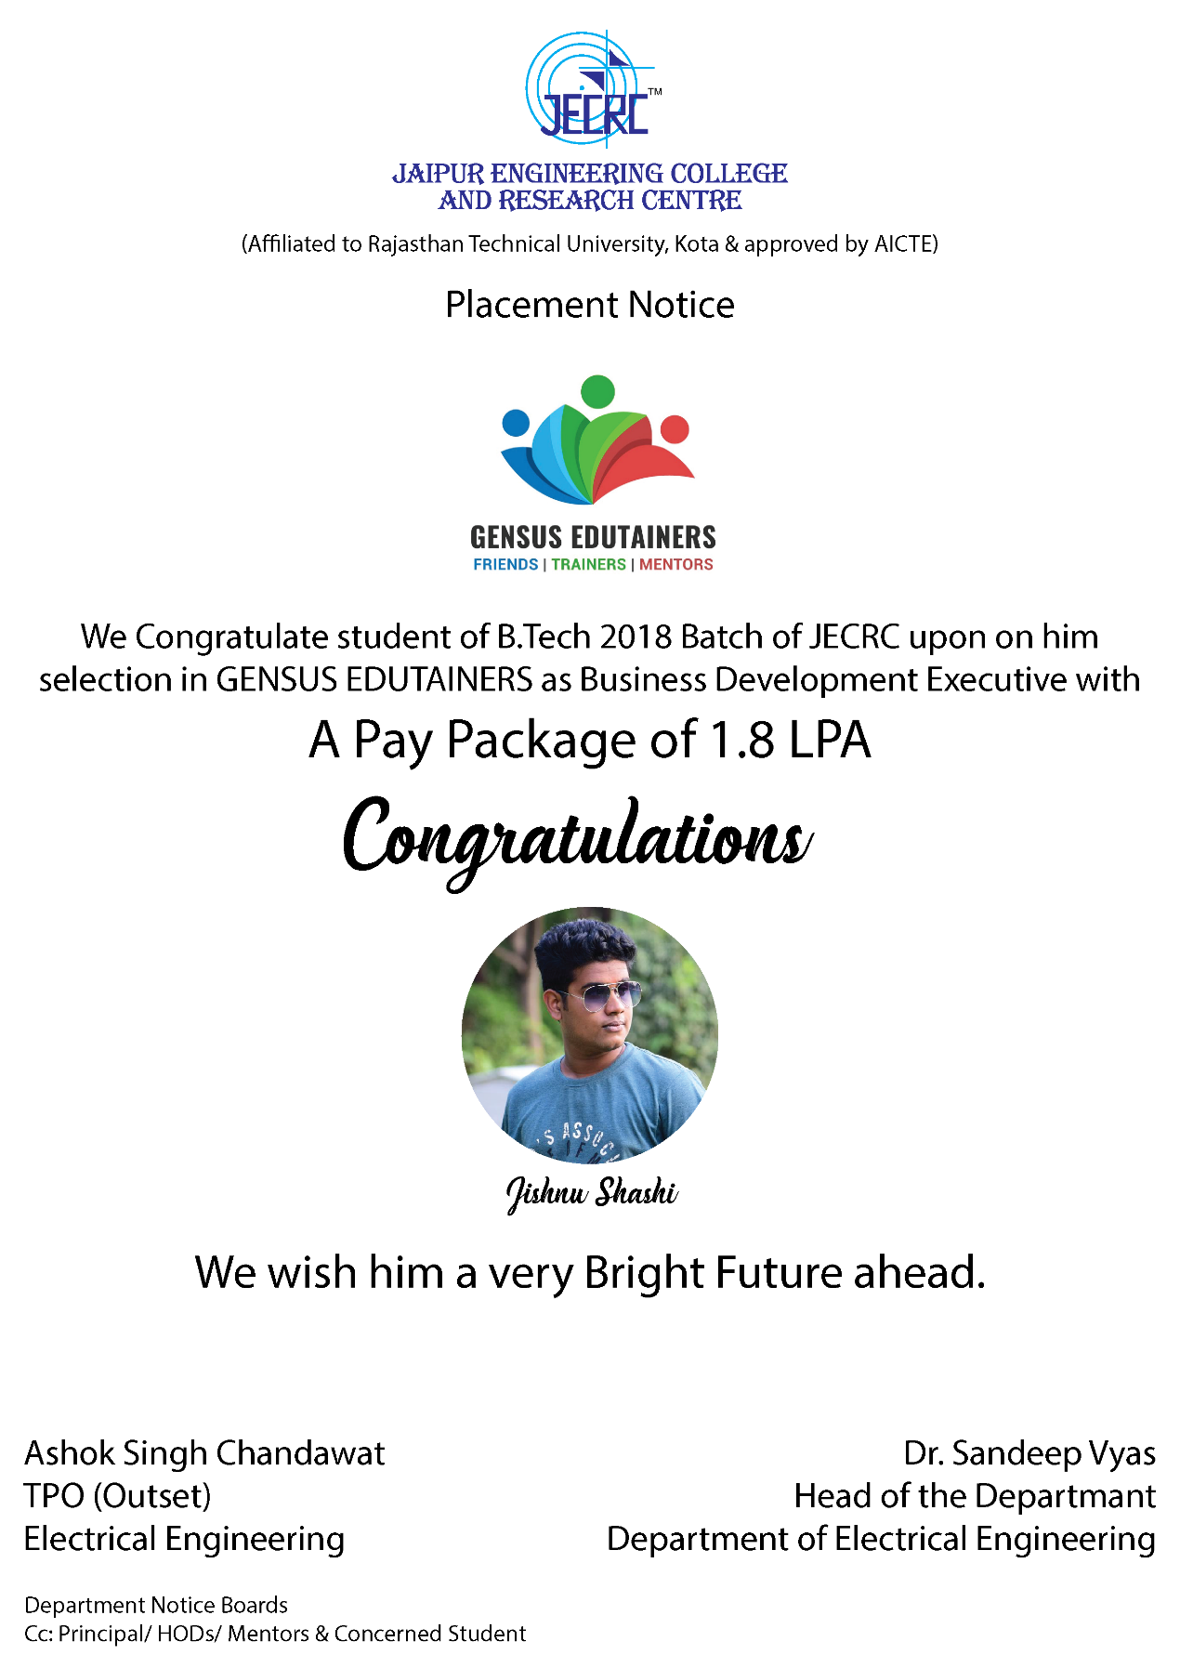
TELSA 10/17

Slide 12
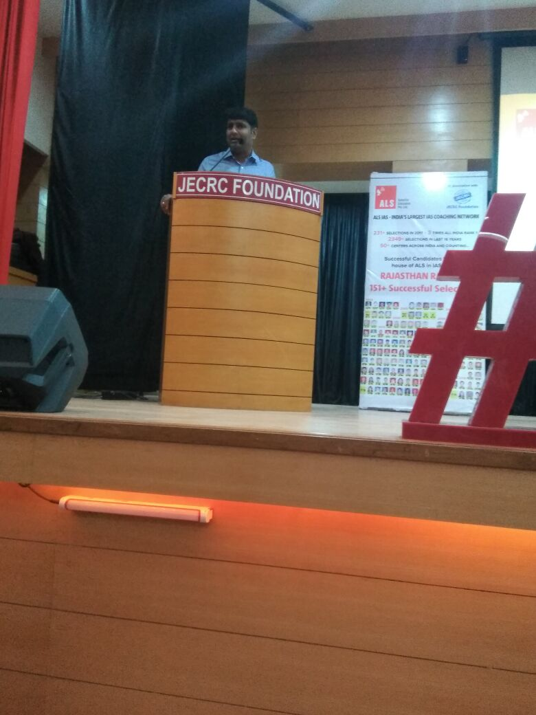
TELSA
10/17
ALS IAS SESSION
On October 9, 2017 JECRC foundation welcomed the faculty of ALS IAS academy to enlighten the students about the UPSC examinations. Mr. Manish K Gautam, Ms. Priyanka and Mr. Rishesh Handa shared their experiences with the students. The session began with a brief description of the courses offered by ALS by Mr. Ritesh Handa . He also introduced Mr Manish K Gautam to the students.
After graduating in Mathematics from BHU, Mr Manish K Gautam too underwent the rigours of Civil Services' preparation. He also had a short stint as a student of LLB at the Campus Law Centre, University of Delhi before joining the Central Industrial Security Force (CISF). He told the students about how this exam is easy to be cracked through the right strategic approach. He also shared his life experiences with the students. After his session he answered the doubts of the students which was followed by information regarding the collaboration of JECRC group of colleges with this premium institution which will involve VSAT classes in the college .The session ended with vote of thanks by professor P K Tiwari.

Slide 13
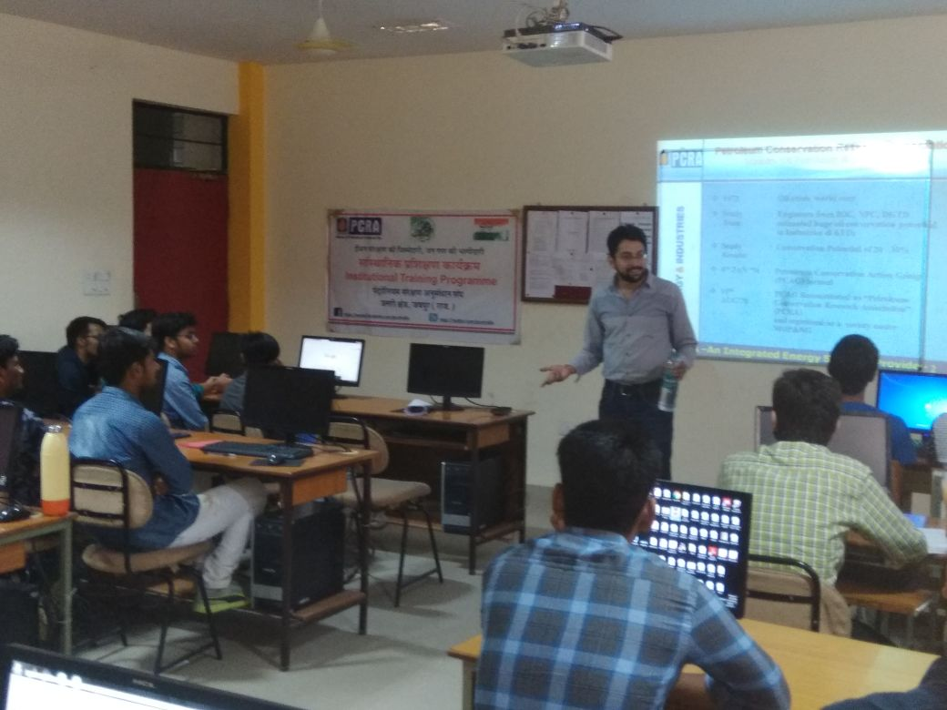

TESLA 10/17
PCRA WORKSHOP
(Petroleum Conservation Research Association Government of India)
A Expert lecturer , “Fuel conservation and Future Trends in Automobile Sector” , was held on 28/10/2017 at BLG-08 B block of the campus. 26 Students of 5th semester participated in the Workshop and learned how to conserve energy in various sector like industrial, domestic, transportation and agriculture. Importance of ISO 9000 were also discussed.
Certificate were distributed to the all participants. Feedback from students was positive, it was a great learning and requested that such program may be conducted twice in a semester.
Philosophy
. 8

Slide 14
TESLA 10/17
Outcomes of the event:
Students will be able:
To formulate strategies and promote measures for accelerating conservation of petroleum products leading to environment protection, energy security and sustainable development.
To create awareness among masses about the importance, benefits and methods of conserving petroleum products & clean environment by enhancing information and capacity building.
To understand about the policies and strategies of Govt. of India on petroleum conservation and environment protection aimed at reducing excessive dependence on oil.

Slide 15
TESLA 10/17
FACULTY’S ACHIEVEMENTS
Publications-
Dr. Sandeep Vyas
Paper Name- Numerical Modeling of borosilicate Doped Photonic-Crystal Fiber for Mid-IR Supercontinuum Generation
Name Of Conference/Journal- PIERS 2017 in Singapore
Status(Communicated/Published)- Accepted
Mr . L. Senthil
Paper Name- Advanced Control Method Of Series Voltage Compensation To Enhance Wind Turbine Ride Through
Name Of Conference/Journal- IJSRCSEIT & Journal No:64718
Volume- Volume 2
Status(Communicated/Published)- Published
Mrs.Sonali Chadha
Paper Name- Advanced Control Method Of Series Voltage Compensation To Enhance Wind Turbine Ride Through
Name Of Conference/Journal- IJSRCSEIT & Journal No:64718
Volume- Volume 2
Status(Communicated/Published)- Published

Slide 16
TESLA 10/17
Ms. Poonam Gupta
Paper Name- Advanced Control Method Of Series Voltage Compensation To Enhance Wind Turbine Ride Through
Name Of Conference/Journal- IJSRCSEIT & Journal No:64718
Volume- Volume 2
Status(Communicated/Published)- Published

Slide 17
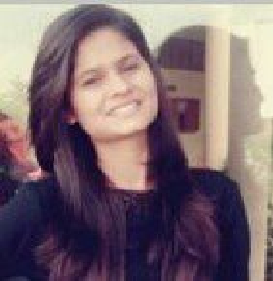
TESLA 10/17
STUDENT’s ACHIEVEMENT
Ms. BHARTI SHARMA (3RD YEAR): Got an internship from NATIONAL GEOGRAPHIC CHANNEL for three months (January to march) with stipend of Rs. 10,000.

Slide 18
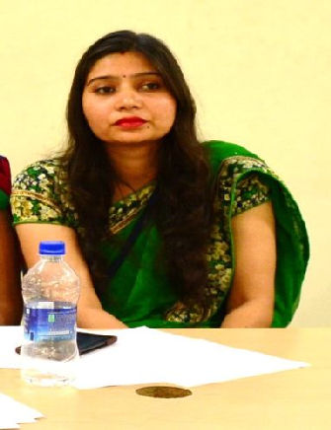
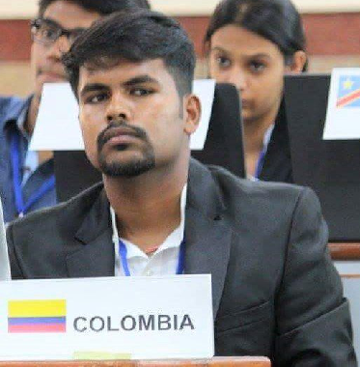
TESLA 10/17
EDITORIAL BOARD
Faculty Coordinator
Ms. Ravita Saraswat
Student Coordinators
Prakhar Joshi
Bharti Sharma

Slide 19
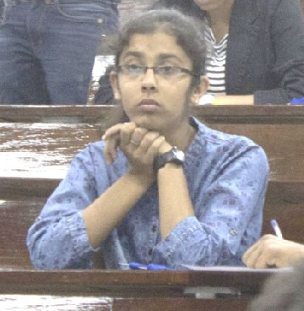
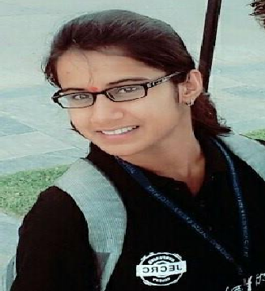
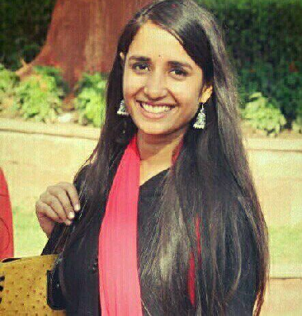
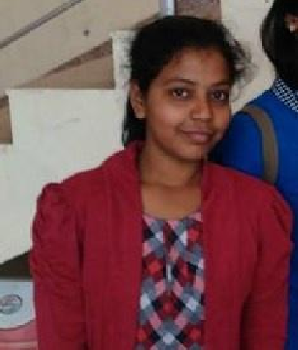
TESLA 10/17
Sakshi Sharma (3rd year)
Akanksha Sinha (3rd year)
Manu Sharma (3rd year)
Mridula Soni (3rd year)

Slide 20
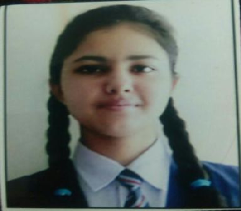
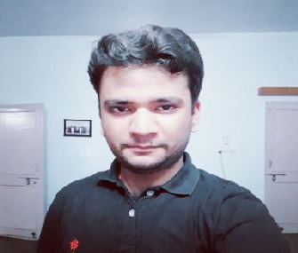

TESLA 10/17
Ujjwal Sharma (2nd year)
Shashwat Tripathi (2nd year)

